Slide 1


SMART INDIA HACKATHON 2024
TITLE PAGE
Problem Statement ID: 1555
Problem Statement Title: Virtual Herbal Garden
Theme: MedTech / BioTech / HealthTech
PS Category: Software
Team ID-
Team Name (Registered on portal): Tejastrix

Slide 2

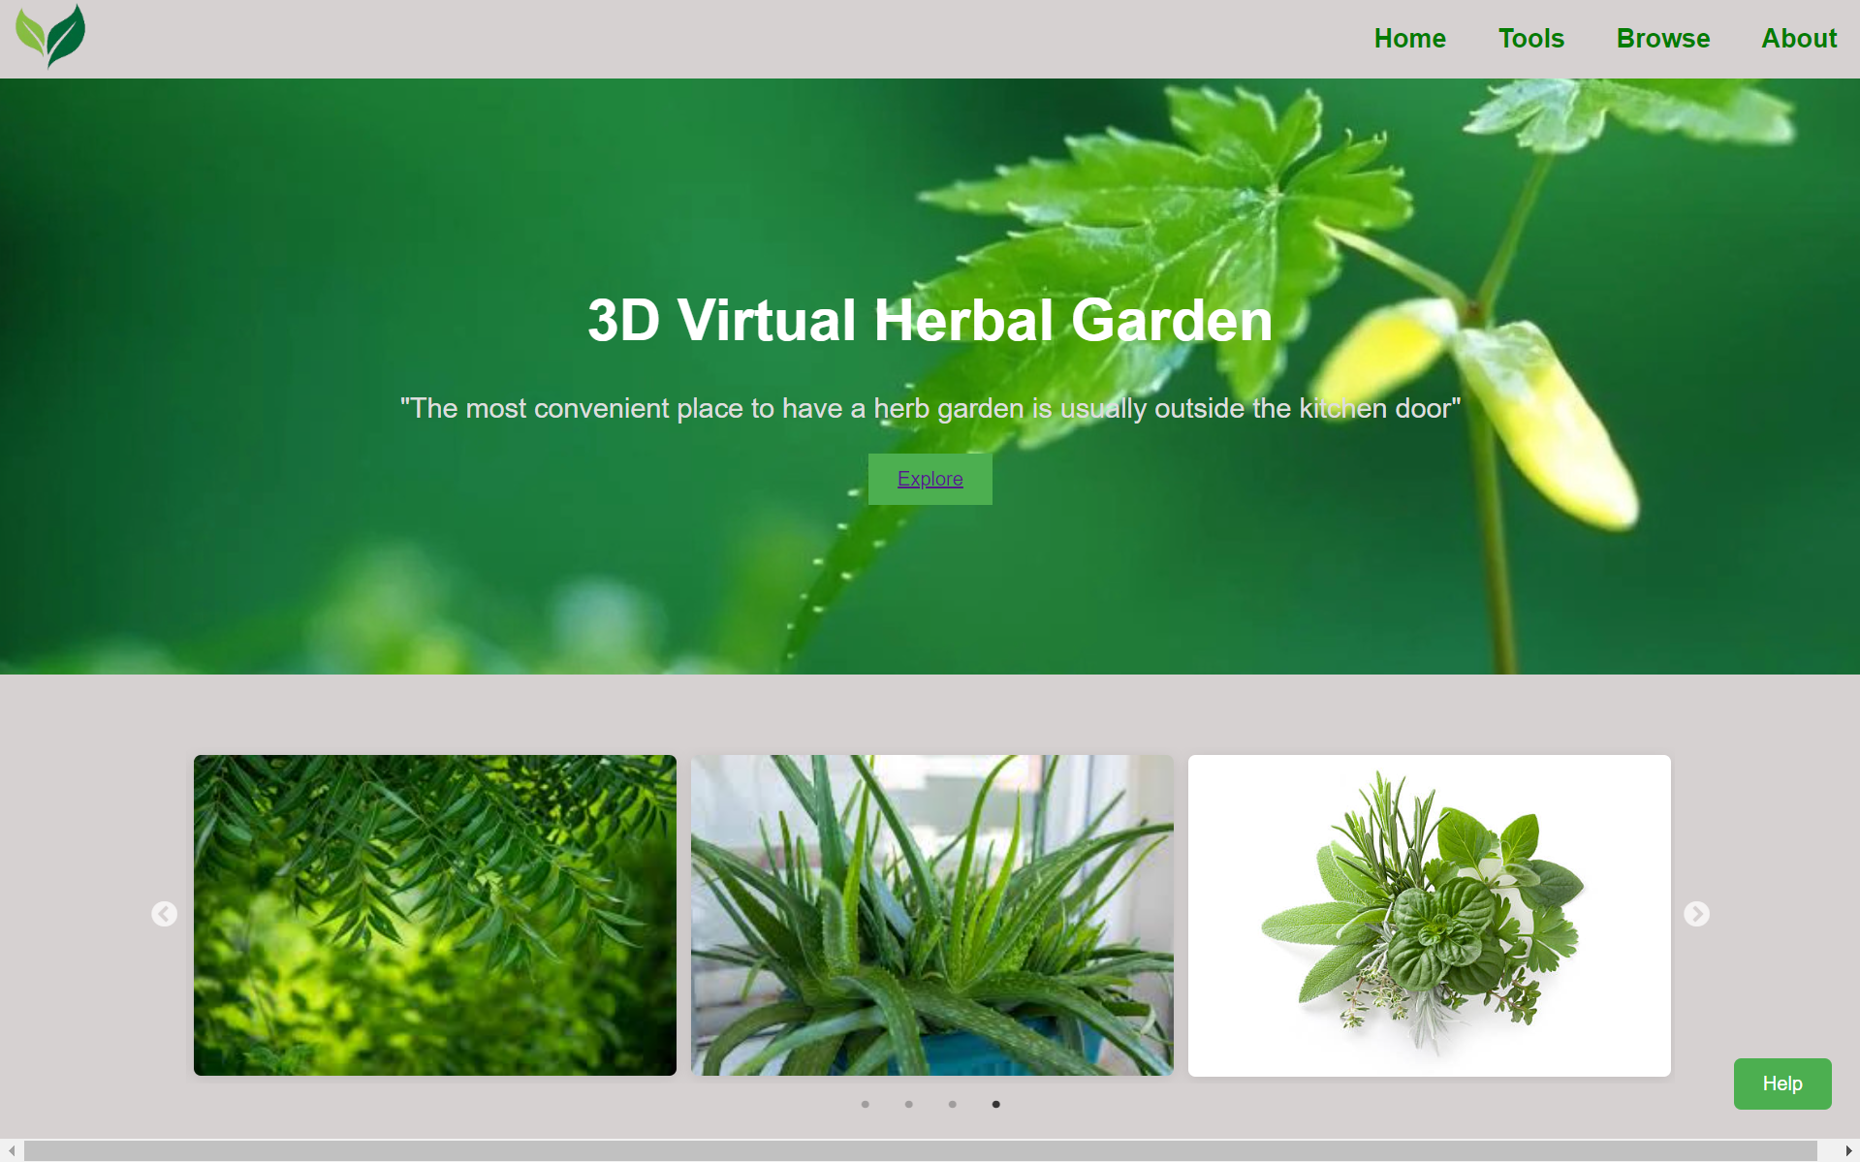
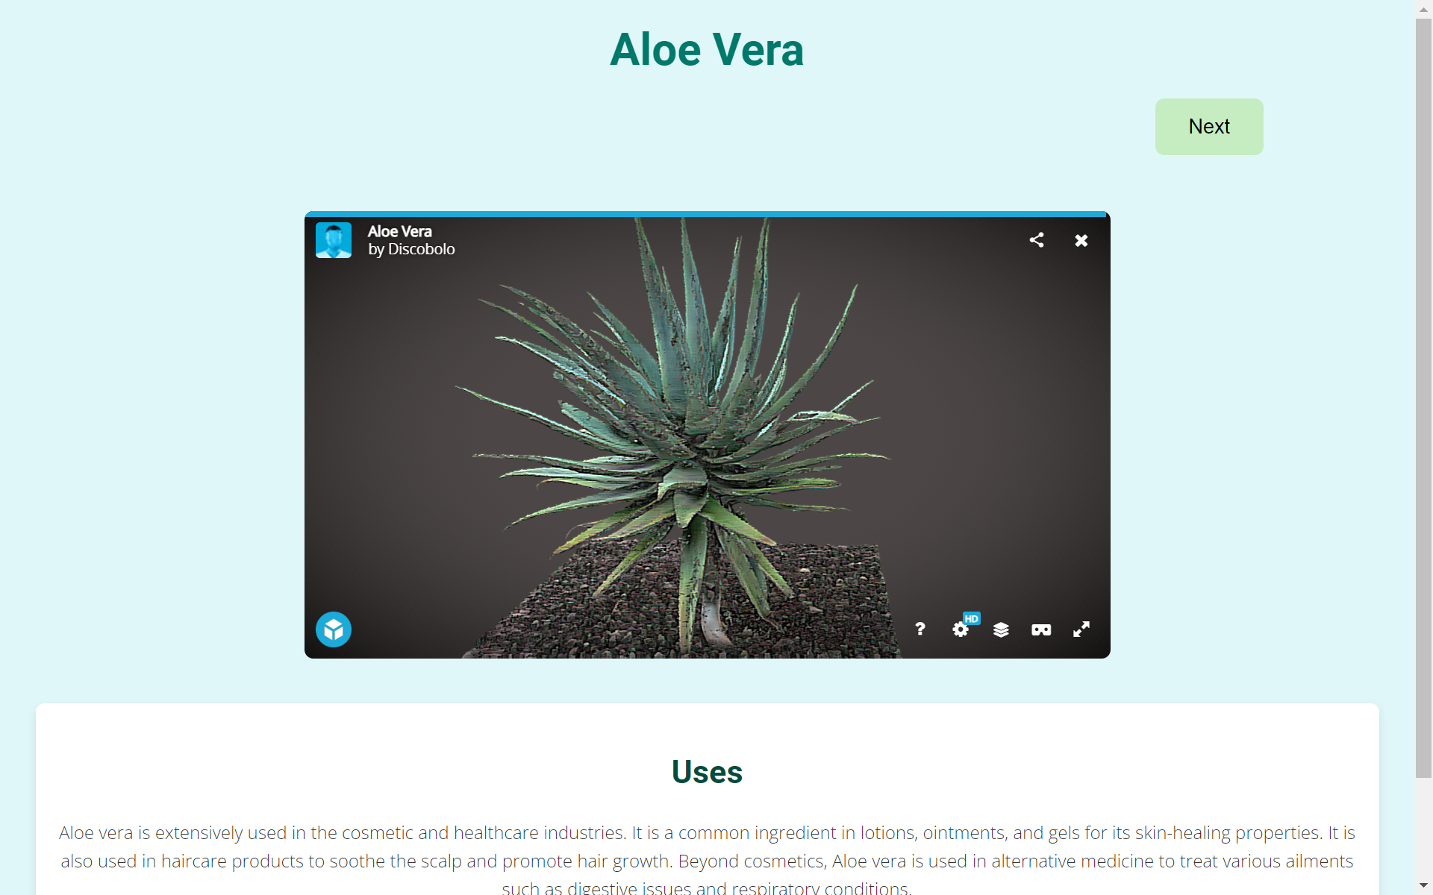
IDEA TITLE
Proposed Solution (Describe your Idea/Solution/Prototype)
Detailed Description: The Virtual Herbal Garden is an interactive digital platform featuring realistic 3D models of medicinal plants, detailed botanical information, multimedia content. Users can explore plants, view them from different angles, and access comprehensive data on their uses and cultivation.
How It Addresses the Problem: It makes medicinal plant knowledge accessible from anywhere, overcoming physical barriers of traditional gardens. By combining detailed information with immersive technology, it bridges educational gaps and engages users more effectively.
Innovation and Uniqueness: The platform's use of interactive 3D models, multimedia elements and offers an immersive, comprehensive learning experience. Its integration of personalized features and social sharing sets it apart from traditional and digital resources.

Slide 3




TECHNICAL APPROACH
Programming Language and Technologies:
HTML
CSS
JS
Python
Sketchfab (for embedding 3D models)
Skypack (To import npm packages)

Slide 4
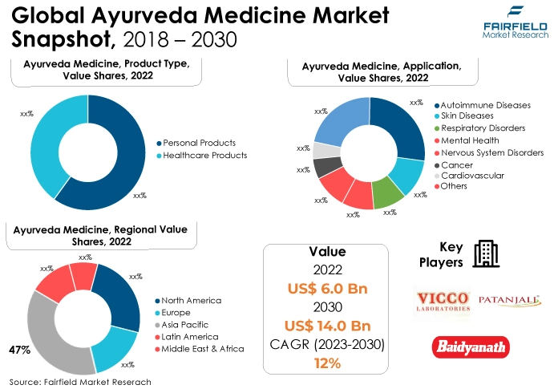
FEASIBILITY AND VIABILITY
Feasibility of the Idea:
Technological Feasibility: Advances in technology support interactive 3D models and multimedia content.
Growing Demand: Rising interest in digital learning tools and accessible educational resources.
Widespread Use: Increased use of internet-connected devices enhances accessibility.
Technical Complexity
Content Accuracy
User Experience
Accessibility
Maintenance and Updates
Strategies for Overcoming These Challenges:
Optimize the platform for various devices and internet speeds by implementing responsive design and providing lower-resolution options. Consider offline access for essential content.

Slide 5
IMPACT AND BENEFITS
Interactive Learning: Offers 3D models and detailed plant information for an engaging educational experience.
Accessibility: Bridges educational gaps, making traditional herbal knowledge more accessible.
Global Awareness: Promotes global understanding and appreciation of medicinal plants.
Social Benefits: Preserves and promotes herbal traditions, supporting informed health choices.
Economic Impact: Encourages sustainable practices and informed use of medicinal plants.
Environmental Advantage: Supports sustainable use of natural resources and promotes eco-friendly practices.

Slide 6
RESEARCH AND REFERENCES
For 3D models and References:
For Data:
https://bsi.gov.in/page/en/medicinal-plant-database
https://sketchfab.com/sarvagnavemulaaimg/collections/herbal-trees-9063258a34d84299ba7c710d979443d0
https://planner5d.com/use/garden-planner
https://flowerbed.metademolab.com/#

